Slide 1
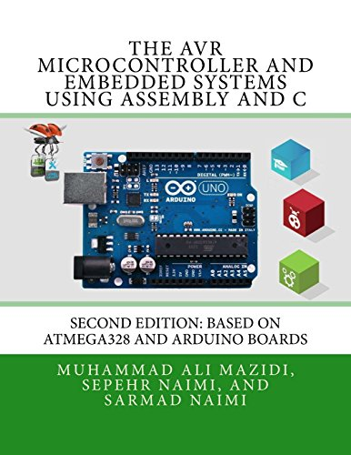

Lecture # 06M: Assembly Language Programming for ATmega328P
Course Teacher: Prof. Dr. Engr. Muhibul Haque Bhuyan
Professor, Department of EEE
American International University-Bangladesh (AIUB)
Dhaka, Bangladesh

Slide 2
Outline
Arduino AVR Architecture
Assembly Language Programming
Examples of Assembly Programming
Flow Chart Drawing and Algorithm Development

Slide 3
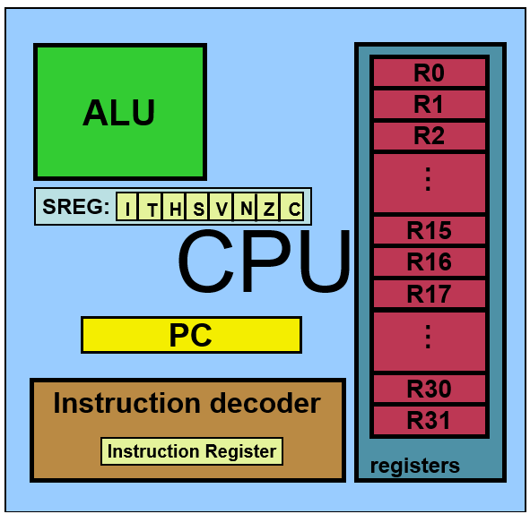
AVR Architecture of CPU
Arithmetic Logic Unit (ALU)
32 General Purpose Register (GPR) ← each 8-bit
Program Counter (PC)
Instruction Decoder
Status Register (SREG)

Slide 4
Status Register
AVR Flags/Status Register
C = Carry Flag, This flag is set whenever there is a carry out from the D7 bit after an arithmetic operation(Addition, subtraction, increment, decrement, etc.). This flag bit is affected after an 8-bit addition or substruction.
Z = Zero Flag, This flag is affected after an arithmetic or logic operation. If the result is zero than Z = 1, else Z = 0.
N = Negative Flag, It reflects the result of an arithmetic operation. If the D7 bit of the result is zero, then N = 0 and the result is positive. Else N = 1 and the result is negative.
V = Overflow Flag,
S = Sign Flag,
H = Half Carry Flag, this bit is set if there is a carry from D3 to D4 bit after ADD or SUB instruction.
T = Bit Copy Storage. Used as a temporary storage for bit. It can be used to copy a bit from a GPR to another GPR.
I = Global Interrupt Enable

Slide 5
Direct Data Register Method
PORTB Register
To assign input- 0
To assign output- 1
DDRB= 0x 05;
Or DDRB= 0b 00000101; PB0 and PB2 are output pin while rest are input.
To write High-1
To write Low-0
PORTB= 0x01;
PORTB= 0b00000001; write PB0 as high.
PB7 | PB6 | PB5 | PB4 | PB3 | PB2 | PB1 | PB0
0 | 0 | 0 | 0 | 0 | 0 | 0 | 1
DDRB Register
PB7 | PB6 | PB5 | PB4 | PB3 | PB2 | PB1 | PB0
0 | 0 | 0 | 0 | 0 | 1 | 0 | 1

Slide 6
Instruction Set Summary
Mnemonics | Operands | Description | Operations | Flags | Clocks
ADD | Rd,Rr | Add two Registers | Rd ← Rd + Rr | Z,C,N,V,H | 1
ADC | Rd,Rr | Add with Carry two Registers | Rd ← Rd + Rr + C | Z,C,N,V,H | 1
SUB | Rd,Rr | Subtract two Registers | Rd ← Rd - Rr | Z,C,N,V,H | 1
SUBI | Rd,K | Subtract Constant from Register | Rd ← Rd - K | Z,C,N,V,H | 1
AND | Rd,Rr | Logical AND Registers | Rd ← Rd • Rr | Z,N,V | 1
OR | Rd,Rr | Logical OR Registers | Rd ← Rd V Rr | Z,N,V | 1
NEG | Rd | Two’s Complement | Rd ← 0x00 - Rd | Z,C,N,V,H | 1
INC | Rd | Increment | Rd ← Rd + 1 | Z,N,V | 1
DEC | Rd | Decrement | Rd ← Rd - 1 | Z,N,V | 1
MUL | Rd,Rr | Multiply Unsigned | R1:R0 ← Rd x Rr | Z,C | 2

Slide 7
Instruction Set Summary
Mnemonics | Operands | Description | Operations | Flags | Clocks
TST | Rd | Test for Zero or Minus | Rd ← Rd • Rd | Z,N,V | 1
CLR | Rd | Clear Register | Rd ← Rd ⊕ Rd | Z,N,V | 1
MOV | Rd, Rr | Move Between Registers | Rd ← Rr | None | 1
LDI | Rd, K | Load Immediate | Rd ← K | None | 1
LDS | Rd, K | Load Direct from data space location K | Rd← [K] | None | 1
IN | Rd, P | From In Port P/ address to Rd register | Rd ← P | None | 1
OUT | P, Rr | From Rr register to Out Port P/ address | P ← Rr | None | 1
PUSH | Rr | Push Register on Stack | STACK ← Rr | None | 2
POP | Rd | Pop Register from Stack | Rd ← STACK | None | 2
NOP |  | No Operation | None | 1
BREAK |  | Break | For On-chip Debug Only | None | N/A

Slide 8
Instruction Set Summary
Mnemonics | Operands | Description | Operations | Flags | Clocks
STS | K, Rr | Store Rr to data space location K. | [K] ← Rr | None | 1
SBI | A, b | Sets a specified bit in an I/O Register | Sets the b no. bits of the A register | None | 1
CBI | A, b | Resets a specified bit in an I/O Register | Resets the b no bits of the A register | None | 1
SBIC | A, b | Skip if Bit in I/O Register is Cleared/ Reset | If b no bit of A register is 0, then skip PC by 2 or 3. | None | 1
SBIS | A, b | Skip if Bit in I/O Register is set | If b no bit of A register is 1, then skip PC by 2 or 3. | None | 1
RJUMP | K | Relative jump | PC← PC+K+1 | None | 1

Slide 9
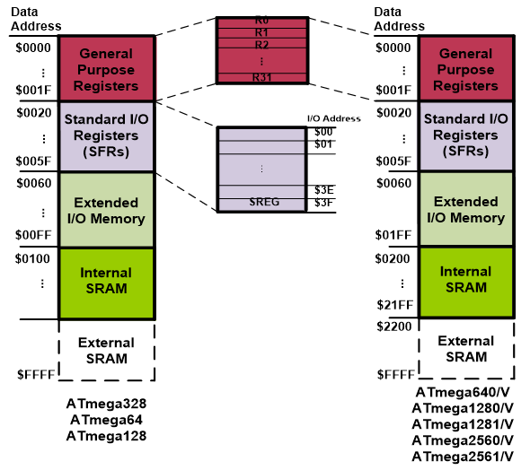
Memory Locations
STS 0x60, R0
LDS R31, 0x01FF

Slide 10
Register Contents
SBI DDRB, 3;
SBIC R7, 5;
DDRB Register
R7 Register
PB7 | PB6 | PB5 | PB4 | PB3 | PB2 | PB1 | PB0
0 | 0 | 0 | 0 | 0 | 1 | 0 | 0
8 | 7 | 6 | 5 | 4 | 3 | 2 | 1
1 | 1 | 1 | 0 | 1 | 1 | 1 | 1
PC = PC+2 or 3
CBI DDRB, 5;
SBIS R8, 5;
DDRB Register
R8 Register
PB7 | PB6 | PB5 | PB4 | PB3 | PB2 | PB1 | PB0
0 | 0 | 0 | 0 | 0 | 0 | 0 | 0
8 | 7 | 6 | 5 | 4 | 3 | 2 | 1
1 | 1 | 1 | 1 | 1 | 1 | 1 | 1
PC = PC+2 or 3

Slide 11
Programming Examples
Example: State the contents of R20, R21, and data memory location of 0x120 after executing the following program.
Example: State the contents of RAM locations of $212, $213, $214, $215, and $216 after executing the following program.
LDI R20, 5;
LDI R21, 2;
ADD R20,R21;
ADD R20,R21;
STS 0x120, R20;
Solution:
LDI R20, 5; R20=5
LDI R21, 2; R21=2
ADD R20, R21; R20=5+2=7
ADD R20, R21; R20= 7+2=9
STS 0x120, R20; 0x120 = 9
R20= 9
R21= 2
0x120= 9
LDI R16, 0x99
STS 0x212, R16
LDI R16, 0x85
STS 0x213, R16
LDI R16, 0x3F
STS 0x214, R16
LDI R16, 0x63
STS 0x215, R16
LDI R16, 0x12
STS 0x216, R16
Solution:
0x212 | 0x99
0x213 | 0x85
0x214 | 0x3F
0x215 | 0x63
0x216 | 0x12

Slide 12
Difference Between Assembly and C
Assembly Code Example
sei ; set Global Interrupt Enable sleep; enter sleep, waiting for interrupt ; note: will enter sleep before any pending interrupt(s)
C Code Example
__enable_interrupt(); /* set Global Interrupt Enable */ __sleep(); /* enter sleep, waiting for interrupt */ /* note: will enter sleep before any pending interrupt(s) */

Slide 13
EEPROM Control Register (EECR)
7 | 6 | 5 | 4 | 3 | 2 | 1 | 0
 |  | EEPM(1:0) |  | EERIE | EEMPE | EEPE | EERE
SBIC EECR, EEPE; If EEPE bit of EECR is 0 then the Program Counter (PC) will skip 2 or 3 steps.

Slide 14
Difference Between Assembly and C
Assembly Code Example
EEPROM_write: ; Wait for completion of previous write sbic EECR,EEPE rjmp EEPROM_write ; Set up address (r18:r17) in address register out EEARH, r18 out EEARL, r17 ; Write data (r16) to Data Register out EEDR,r16 ; Write logical one to EEMPE sbi EECR,EEMPE ; Start eeprom write by setting EEPE sbi EECR,EEPE ret
C Code Example
void EEPROM_write(unsigned int uiAddress, unsigned char ucData) { /* Wait for completion of previous write */ while(EECR & (1<<EEPE)) ; /* Set up address and Data Registers */ EEAR = uiAddress; EEDR = ucData; /* Write logical one to EEMPE */ EECR |= (1<<EEMPE); /* Start eeprom write by setting EEPE */ EECR |= (1<<EEPE); }

Slide 15
The next code examples show assembly and C functions for reading the EEPROM. The examples assume that interrupts are controlled so that no interrupts will occur during the execution of these functions.
Functions of Assembly and C
Assembly Code Example
EEPROM_read: ; Wait for completion of previous write sbic EECR,EEPE rjmp EEPROM_read ; Set up address (r18:r17) in address register out EEARH, r18 out EEARL, r17 ; Start eeprom read by writing EERE sbi EECR,EERE ; Read data from Data Register in r16,EEDR ret
C Code Example
unsigned char EEPROM_read(unsigned int uiAddress) { /* Wait for completion of previous write */ while(EECR & (1<<EEPE)) ; /* Set up address register */ EEAR = uiAddress; /* Start eeprom read by writing EERE */ EECR |= (1<<EERE); /* Return data from Data Register */ return EEDR; }

Slide 16
Bit 0 – IVCE: Interrupt Vector Change Enable The IVCE bit must be written to logic one to enable change of the IVSEL bit. IVCE is cleared by hardware four cycles after it is written or when IVSEL is written. Setting the IVCE bit will disable interrupts,
Functions of Assembly and C
Assembly Code Example
Move_interrupts: ; Enable change of Interrupt Vectors ldi r16, (1<<IVCE) out MCUCR, r16 ; Move interrupts to Boot Flash section ldi r16, (1<<IVSEL) out MCUCR, r16 ret
C Code Example
void Move_interrupts(void) { /* Enable change of Interrupt Vectors */ MCUCR = (1<<IVCE); /* Move interrupts to Boot Flash section */ MCUCR = (1<<IVSEL); }

Slide 17
The assembly code example returns the TCNT1 value in the r17:r16 register pair. If an interrupt occurs between the two instructions accessing the 16-bit register, the interrupt code updates the temporary register by accessing the same or any other of the 16-bit Timer Registers, then the result of the access outside the interrupt will be corrupted. Therefore, when both the main code and the interrupt code update the temporary register, the main code must disable the interrupts during the 16-bit access.
Functions of Assembly and C
Assembly Code Example
; Set TCNT1 to 0x01FF ldi r17,0x01 ldi r16,0xFF out TCNT1H,r17 out TCNT1L,r16 ; Read TCNT1 into r17:r16 in r16,TCNT1L in r17,TCNT1H ...
C Code Example
unsigned int i; ... /* Set TCNT1 to 0x01FF */ TCNT1 = 0x1FF; /* Read TCNT1 into i */ i = TCNT1; ...

Slide 18
The following code examples show how to do an atomic read of the TCNT1 Register contents. Reading any of the OCR1A/B or ICR1 Registers can be done by using the same principle
Functions of Assembly and C
Assembly Code Example
TIM16_ReadTCNT1: ; Save global interrupt flag in r18,SREG ; Disable interrupts cli ; Read TCNT1 into r17:r16 in r16,TCNT1L in r17,TCNT1H ; Restore global interrupt flag out SREG,r18 ret
C Code Example
uunsigned int TIM16_ReadTCNT1( void ) { unsigned char sreg; unsigned int i; /* Save global interrupt flag */ sreg = SREG; /* Disable interrupts */ _CLI(); /* Read TCNT1 into i */ i = TCNT1; /* Restore global interrupt flag */ SREG = sreg; return i;

Slide 19
The assembly code example returns the TCNT1 value in the r17:r16 register pair. The following code examples show how to do an atomic write of the TCNT1 Register contents. Writing any of the OCR1A/B or ICR1 Registers can be done by using the same principle
Functions of Assembly and C
Assembly Code Example
TIM16_ReadTCNT1: ; Save global interrupt flag in r18,SREG ; Disable interrupts cli ; Read TCNT1 into r17:r16 in r16,TCNT1L in r17,TCNT1H ; Restore global interrupt flag out SREG,r18 ret
C Code Example
unsigned int TIM16_ReadTCNT1( void ) { unsigned char sreg; unsigned int i; /* Save global interrupt flag */ sreg = SREG; /* Disable interrupts */ _CLI(); /* Read TCNT1 into i */ i = TCNT1; /* Restore global interrupt flag */ SREG = sreg; return i; }

Slide 20
The assembly code example requires that the r17:r16 register pair contains the value to be written to TCNT1.
Functions of Assembly and C
Assembly Code Example
TIM16_WriteTCNT1: ; Save global interrupt flag in r18,SREG ; Disable interrupts cli ; Set TCNT1 to r17:r16 out TCNT1H,r17 out TCNT1L,r16 ; Restore global interrupt flag out SREG,r18 ret
C Code Example
void TIM16_WriteTCNT1( unsigned int i ) { unsigned char sreg; unsigned int i; /* Save global interrupt flag */ sreg = SREG; /* Disable interrupts */ _CLI(); /* Set TCNT1 to i */ TCNT1 = i; /* Restore global interrupt flag */ SREG = sreg; }

Slide 21
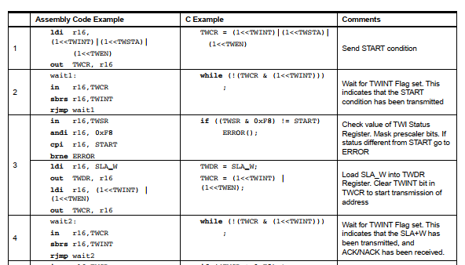
Difference Between Assembly and C

Slide 22
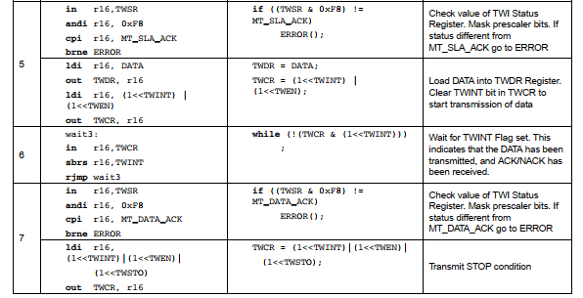
Difference Between Assembly and C

Slide 23
The first design of flowchart goes back to 1945 which was designed by John Von Neumann. Unlike an algorithm, Flowchart uses different symbols to design a solution to a problem. It is another commonly used programming tool. By looking at a Flowchart, one can understand the operations and sequence of operations performed in a system. A flowchart is often considered a blueprint of a design used for solving a specific problem. A flowchart is a diagrammatic representation of an algorithm. Flowcharts are very helpful in writing programs and explaining programs to others. Though, flowcharts are useful in efficient coding, debugging, and analysis of a program, drawing flowcharts for very complicated in case of complex programs is often ignored. Flowcharts use special shapes to represent different types of actions or steps in a process. Lines and arrows show the sequence of the steps and the relationships among them. These are known as flowchart symbols. So, flowchart symbols are specific shapes used to create a visual representation of a program.
Flowchart

Slide 24
1. A flowchart is an excellent way of communicating the logic of a program. 2. Easy and efficient to analyze the problem using a flowchart. 3. During the program development cycle, the flowchart plays the role of a blueprint, which makes the program development process easier. 4. After the successful development of a program, it needs continuous timely maintenance during the course of its operation. The flowchart makes a program or system maintenance easier. 5. It is easy to convert the flowchart into any programming language code.
Advantages of Flowchart

Slide 25
While creating flowchart, the following mathematical operators are used.
Commonly used Operators in Flowchart
Operator | Meaning | Example | Remarks
+ | Addition | A + B | Values in A and B will be added
- | Subtraction | A – B | Values of B will be subtracted from that of A
* | Multiplication | A * B | Values of B will be multiplied by that of A
/ | Division | A/B | Values of A will be divided by that of B
^ | Power | A^3 | Values of A will be raised by a power of 3
% | Remainder | A%B | Values of A will be divided by that of A to get a remainder (if any)

Slide 26
While creating flowchart, the following relational operators are used.
Commonly used Operators in Flowchart
Operator | Meaning | Example | Remarks
< | Less than | A < B | Value in A is less than that of B
<= | Less than or equal to | A <= B | Value in A is less than or equal to that of B
= or == | Equal to | A = B or A == B | Values of A and B are equal
# or != | Not Equal to | A # B, A != B | Values of A and B are not equal
> | Greater than | A > B | Value in A is greater than that of B
>= | Greater than or equal to | A >= B | Value in A is greater than or equal to that of B

Slide 27
While creating flowchart, the following logical operators are used.
Commonly used Operators in Flowchart
Operator | Meaning | Example | Remarks
AND | Logical AND | A˄B | Values in A and B will be ANDed
OR | Logical OR | A˅B | Values in A and B will be ORed
NOT | Logical NOT | !A | Values in A will be inverted

Slide 28
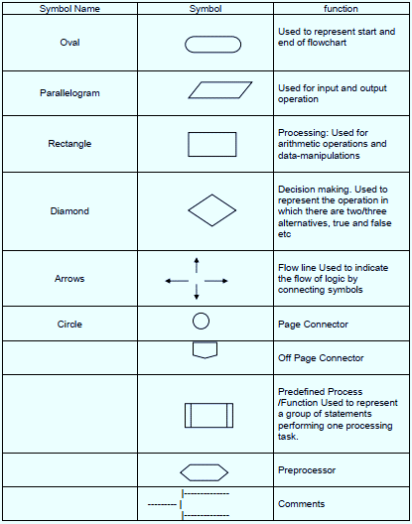
While creating a flowchart, the following symbols are used.
Commonly used Symbols in Flowchart
Rectangle Shape - Represents a process
Oval or Pill Shape - Represents the start or end
Diamond Shape - Represents a decision
Parallelogram - Represents input/output
Circle - Represents reference/page connector
Arrow - Represents a connection between shapes

Slide 29
Draw a flowchart along with its algorithm to add two numbers entered by the user.
Examples of Flowchart
An algorithm to find the sum of two numbers:
Step 1: Start
Step 2: Declare three variables
Step 3: Read numbers and store them in the declared variables
Step 4: Sum these two numbers and assign them to the declared variable
Step 5: Display the sum
Step 6: Stop

Slide 30
Draw a flowchart along with its algorithm to convert temperature from Celsius to Fahrenheit.
Examples of Flowchart
Step 1: Start
Step 2: Declare two variables
Step 3: Read the temperature value in Celsius scale and store it in one of the declared variables
Step 4: Apply the formula of temperature conversion i.e., F = (9*C)/5 + 32 to the convert Celsius value in Fahrenheit scale and store it in the declared variable
Step 5: Display the temperature in Fahrenheit scale
Step 6: Stop

Slide 31
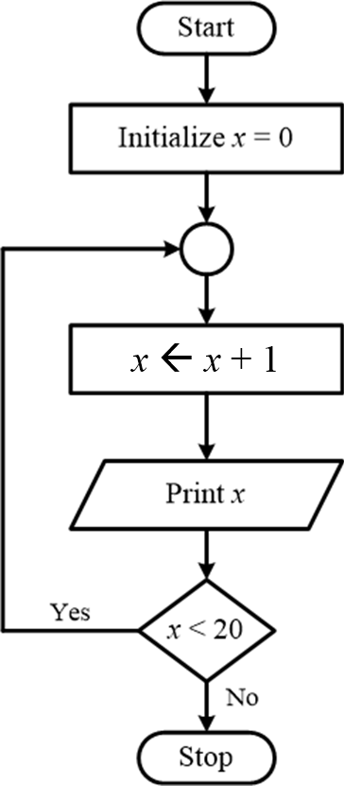
Draw a flowchart along with its algorithm to print numbers from 1 to 20.
Examples of Flowchart
Step 1: Start
Step 2: Declare and initialize a variable with a 0 value
Step 3: Increment the variable value by 1 and store it in the same declared variable
Step 4: Print the value stored in the variable
Step 5: If the variable is < 20 then go to step 3, otherwise go to the next step
Step 6: Stop

Slide 32
Thanks for attending….
?

